Slide 1
Learning Objective
I will be able to solve problems involving conditional probability
Success Criteria
At the end of the lesson, I will be able to:
be able to use Venn diagram, two-way table and tree diagram to derive the conditional probability of a particular event (A) given another event (B) – P(A|B);
be able to construct weighted tree diagrams for multi-stage experiments with the essential elements [branches, weights, events, sample space and probabilities]; and
understand how to use the tree diagrams to calculate conditional probability.

Slide 2

Concept Development
Conditional Probability
The probability of A given B is written as
$$P\left(A|B\right)=\frac{P\left(A∩B\right)}{P\left(B\right)}$$

Slide 3
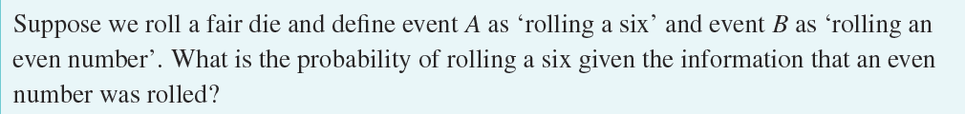
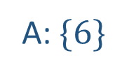

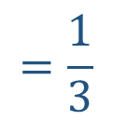


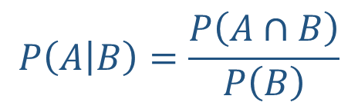

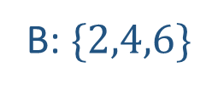
Guided Practice
A: $\{6\}$
B: $\{2,4,6\}$
$$P\left(A | B\right)=\frac{P\left(A∩B\right)}{P\left(B\right)}$$
$$=\frac{1}{3}$$

Slide 4
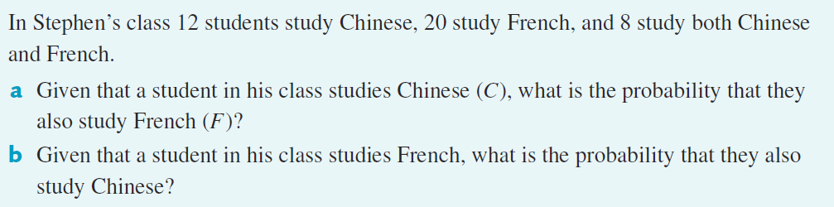

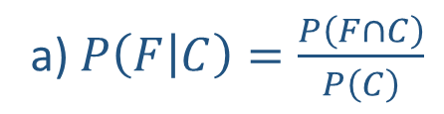


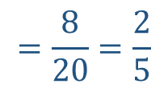
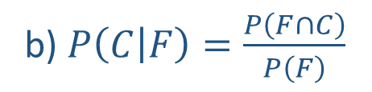

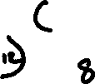
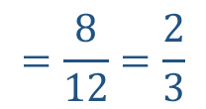
Guided Practice
a) $P\left(F | C\right)=\frac{P\left(F∩C\right)}{P\left(C\right)}$
$$=\frac{8}{12}=\frac{2}{3}$$
b) $P\left(C | F\right)=\frac{P\left(F∩C\right)}{P\left(F\right)}$
$$=\frac{8}{20}=\frac{2}{5}$$

Slide 5
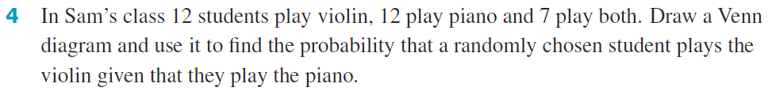

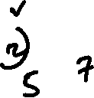
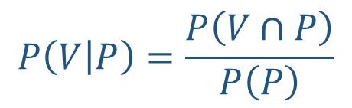



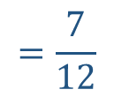
Guided Practice
$$P\left(V | P\right)=\frac{P\left(V∩P\right)}{P\left(P\right)}$$
$$=\frac{7}{12}$$

Slide 6
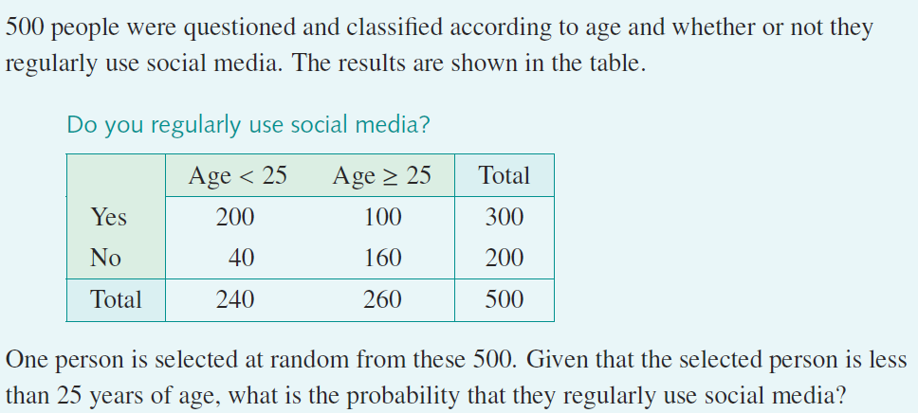


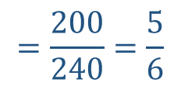
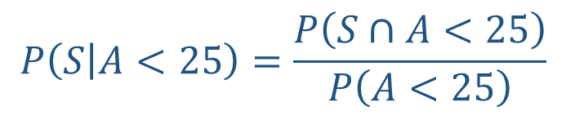
Guided Practice
$$P\left(S | A<25\right)=\frac{P\left(S∩A<25\right)}{P\left(A<25\right)}$$
$$=\frac{200}{240}=\frac{5}{6}$$

Slide 7
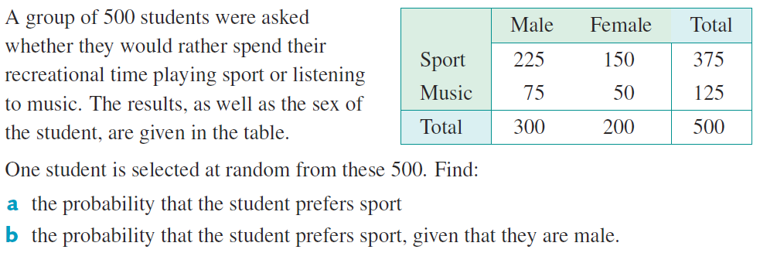

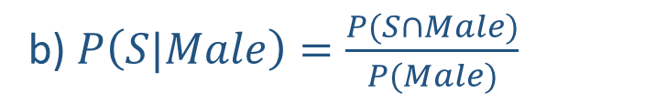
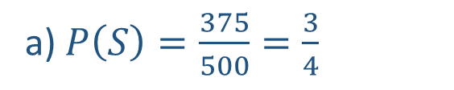
Guided Practice
a) $P\left(S\right)=\frac{375}{500}=\frac{3}{4}$
b) $P\left(S|Male\right)=\frac{P(S∩Male)}{P(Male)}$
$$=\frac{225}{300}=\frac{3}{4}$$

Slide 8
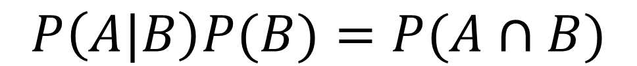
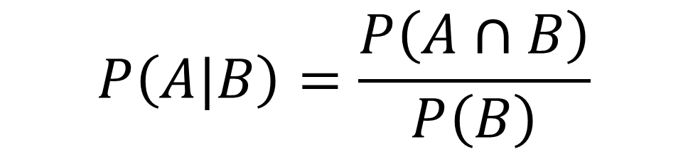
Concept Development
Law of total probability
$$P\left(A\right)=P\left(A | B\right)P\left(B\right)+P\left(A | B^{′}\right)P(B′)$$
$$P\left(A|B\right)=\frac{P\left(A∩B\right)}{P\left(B\right)}$$
$$P\left(A|B\right)P(B)=P(A∩B)$$
$$P\left(A\right)=P(A∩B)+P(A∩B′)$$

Slide 9


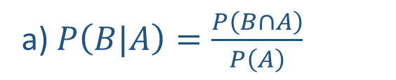

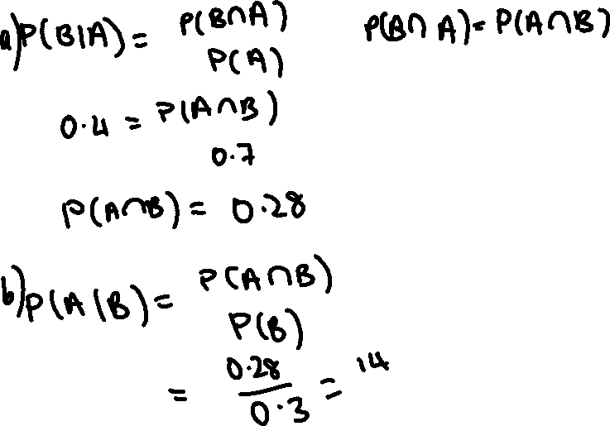

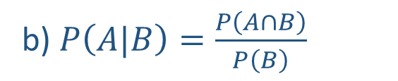

Guided Practice
a) $P\left(B|A\right)=\frac{P\left(B∩A\right)}{P\left(A\right)}$
$$0.4=\frac{P\left(B∩A\right)}{0.7}$$
$$P\left(A∩B\right)=0.28$$
b) $P\left(A|B\right)=\frac{P\left(A∩B\right)}{P\left(B\right)}$
$$=\frac{0.28}{0.3}$$
$$=\frac{28}{30}$$
$$=\frac{14}{15}$$

Slide 10
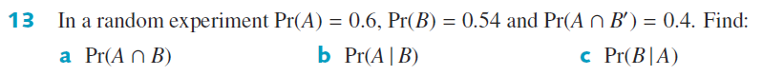
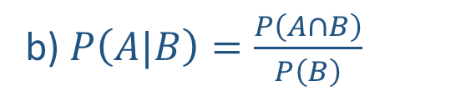


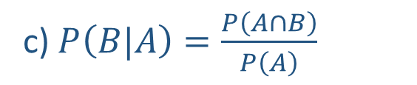

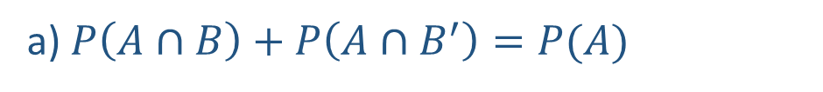



Guided Practice
a) $P\left(A∩B\right)+P\left(A∩B^{′}\right)=P(A)$
c) $P\left(B|A\right)=\frac{P\left(A∩B\right)}{P\left(A\right)}$
$P\left(A∩B\right)+0.4=0.6$
$$=\frac{0.2}{0.6}$$
$P\left(A∩B\right)=0.2$
$$=\frac{1}{3}$$
b) $P\left(A|B\right)=\frac{P\left(A∩B\right)}{P\left(B\right)}$
$$=\frac{0.2}{0.54}$$
$$=\frac{20}{54}$$
$$=\frac{10}{27}$$

Slide 11
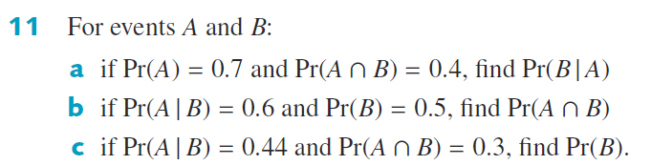


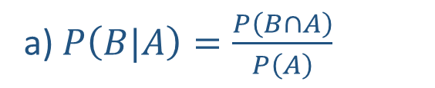
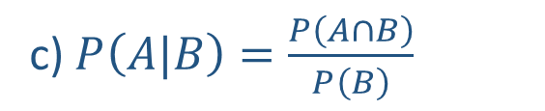


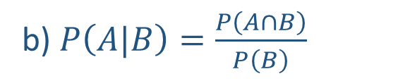
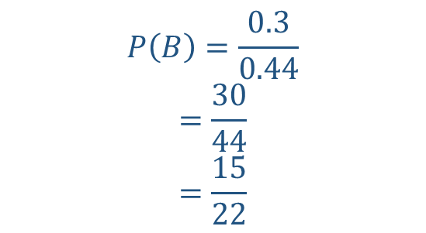
Guided Practice
a) $P\left(B|A\right)=\frac{P\left(B∩A\right)}{P\left(A\right)}$
c) $P\left(A|B\right)=\frac{P\left(A∩B\right)}{P\left(B\right)}$
$$=\frac{0.4}{0.7}=\frac{4}{7}$$
$$0.44=\frac{0.3}{P(B)}$$
b) $P\left(A|B\right)=\frac{P\left(A∩B\right)}{P\left(B\right)}$
$$P\left(B\right)=\frac{0.3}{0.44}$$
$$=\frac{30}{44}$$
$$=\frac{15}{22}$$
$$0.6=\frac{P\left(A∩B\right)}{0.5}$$
$$P\left(A∩B\right)=0.6×0.5=0.3$$

Slide 12
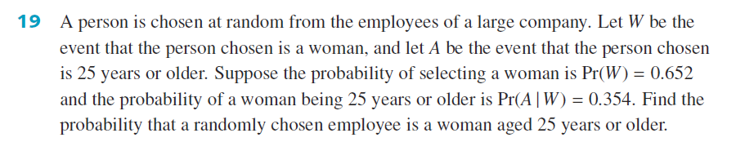




Guided Practice
$P\left(A|W\right)=\frac{P\left(A∩W\right)}{P\left(W\right)}$
$$0.354=\frac{P\left(A∩W\right)}{0.652}$$
$$P\left(A∩W\right)=0.354×0.652$$
$$=0.231$$

Slide 13
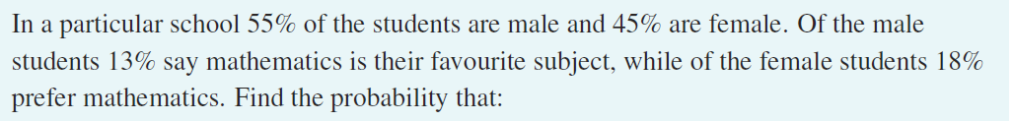








Guided Practice
Draw a tree diagram

Slide 14
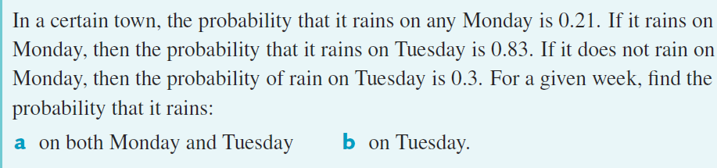











Guided Practice

Slide 15
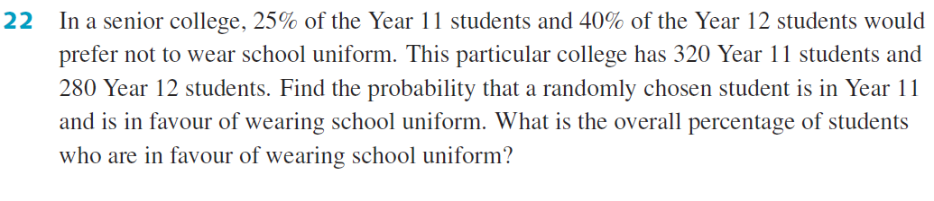


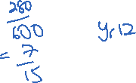

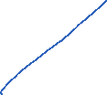



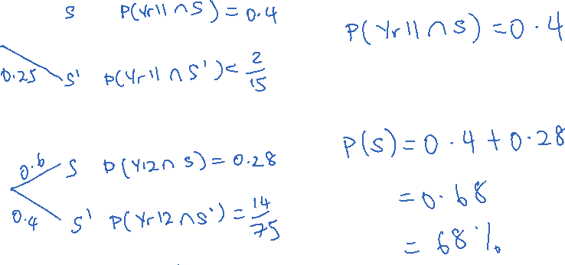
Guided Practice

Slide 16
Independent Practice
Complete Ex 9F

